Slide 1
GMNER: Grounded Multimodal Named Entity Recognition on Social Media
Giuseppe Frigeni
Computer Vision 2024/25

Slide 2
Outline
Problem Statement
Datasets and Metrics
Experimental Setup
Ablation Study
Compression Techniques
Conclusion and Future Work

Slide 3
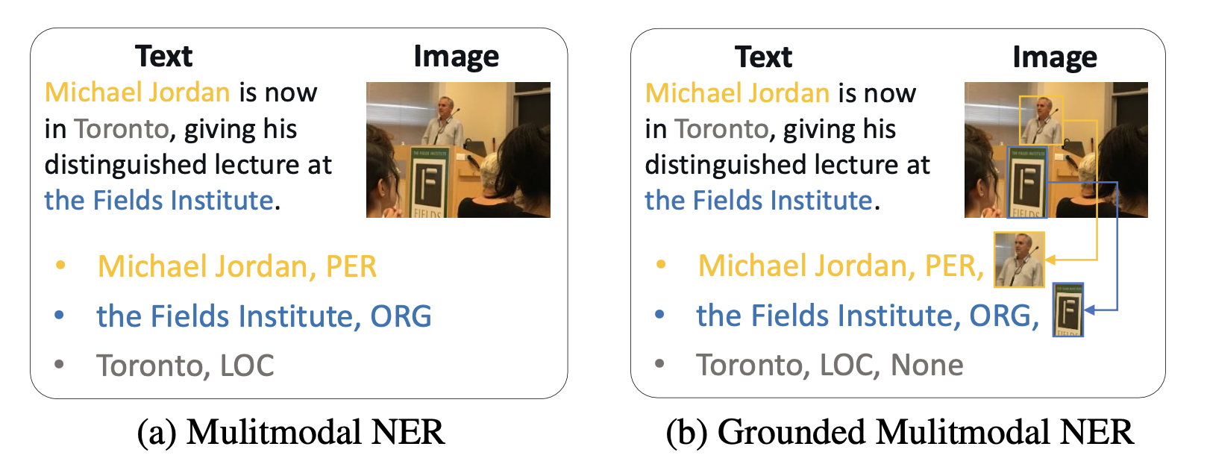
GMNER

Slide 4
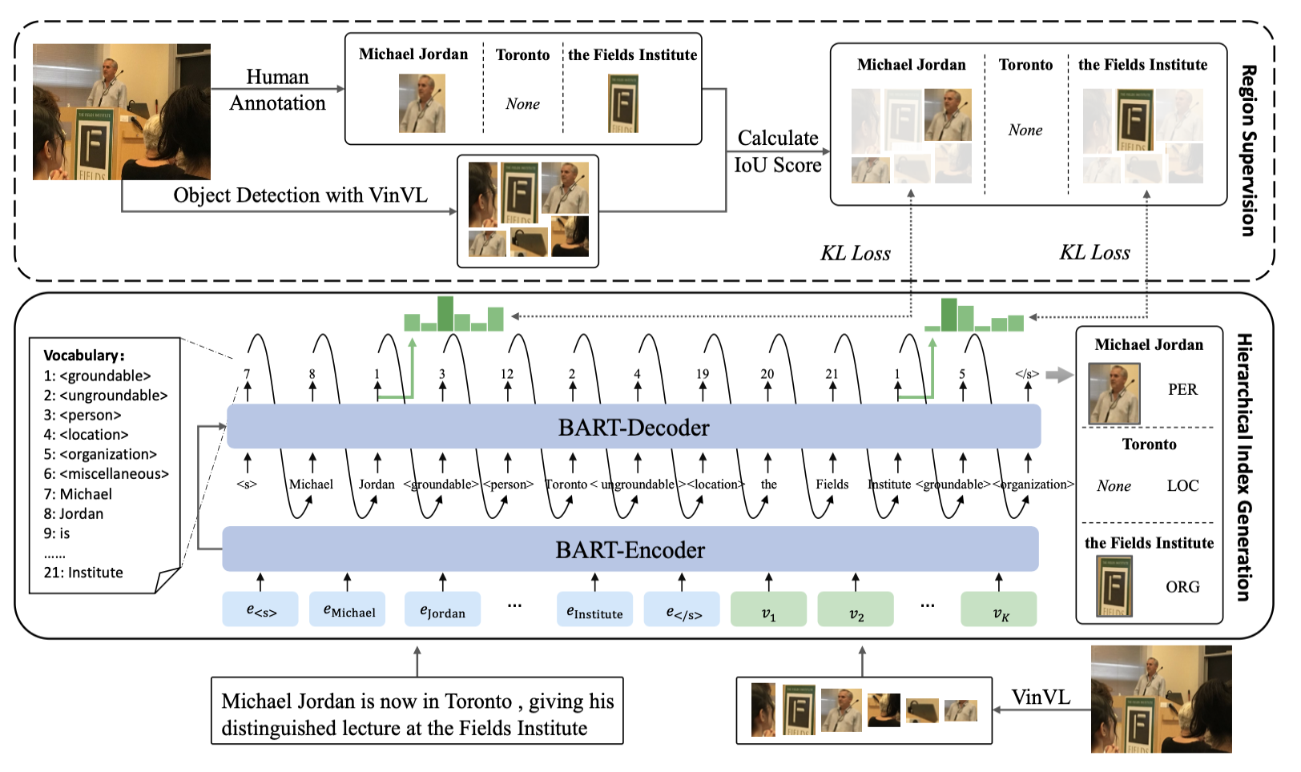
H-Index Framework

Slide 5
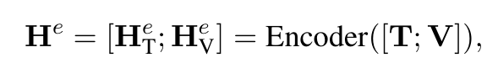
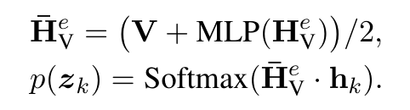
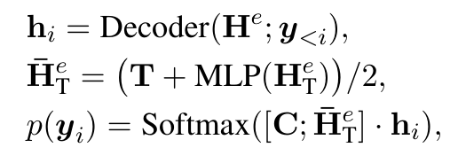
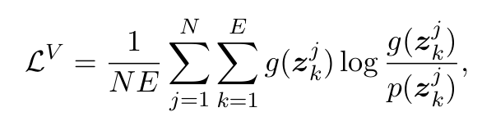
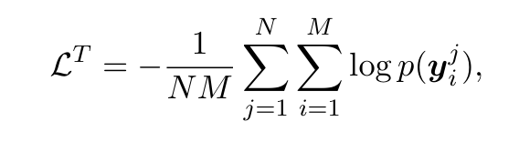
H-Index Framework

Slide 6
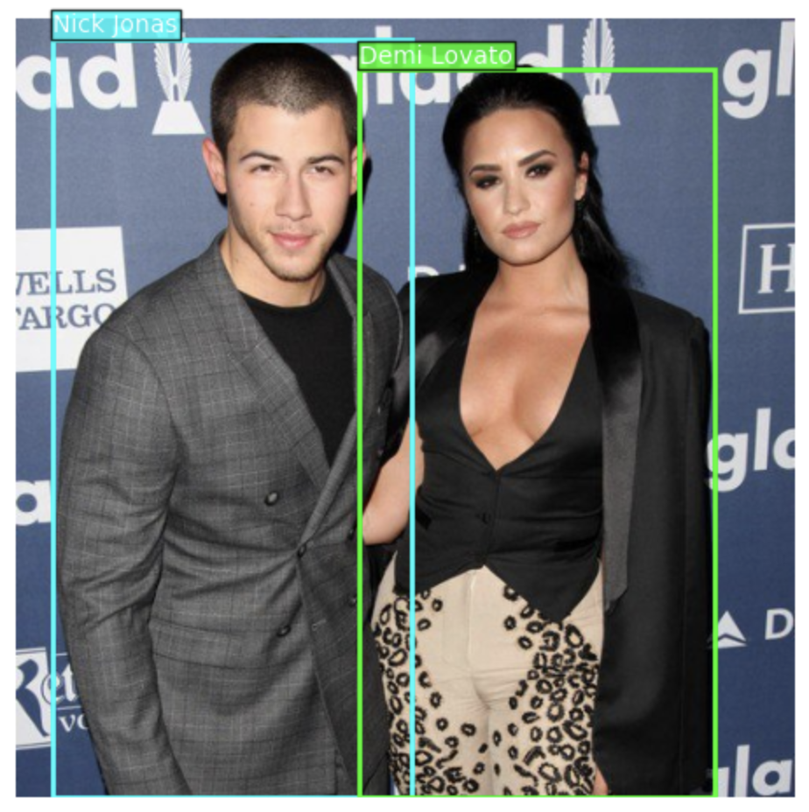
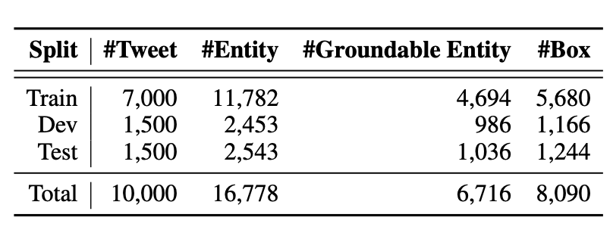
Dataset
Example of tweet:
“Nick Jonas feared pal Demi Lovato would suffer drug death”

Slide 7
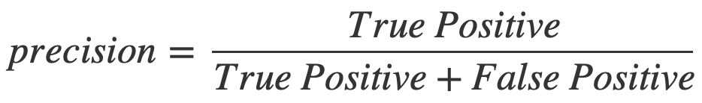
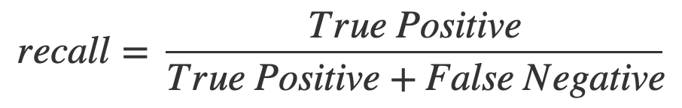
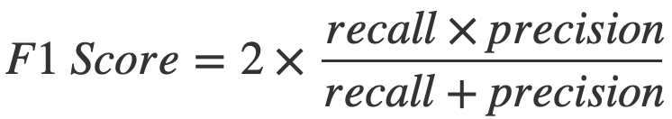
Evaluation metrics
Precision: the ratio of the correct predictions over the total number of positives predicted
Recall: the ratio of correct predictions over the total number of real positives
F1-score: the Harmonic mean between Precision and Recall

Slide 8
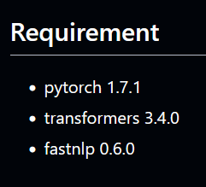
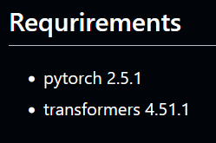


Experimental Setup
Before:
After:

Slide 9
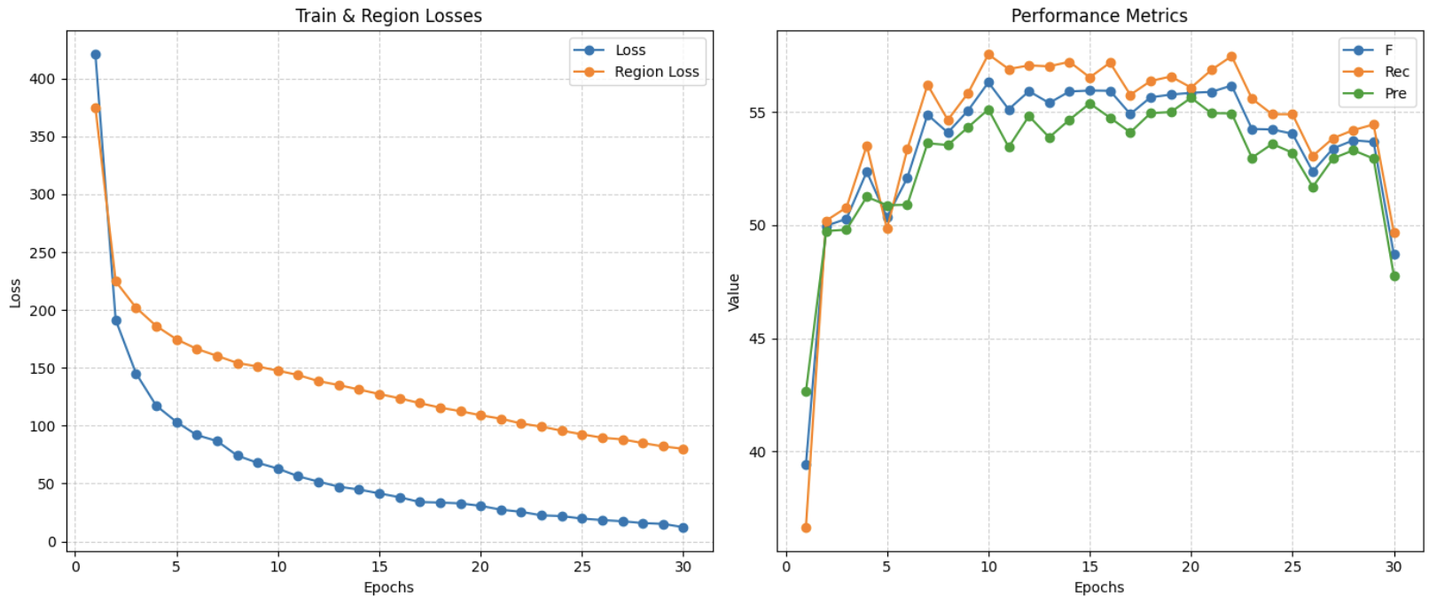
Results
best validation metrics: {'f1': 56.31, 'rec': 57.55, 'pre': 55.12}

Slide 10
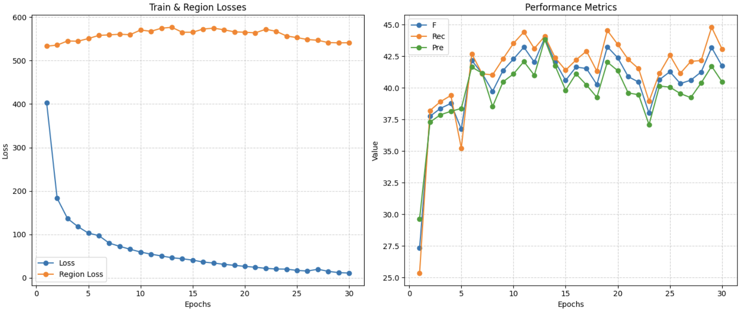
Ablation Study: zeroing the image feature
best validation metrics: {'f1': 43.94, 'rec': 44.08, 'pre': 43.8}

Slide 11
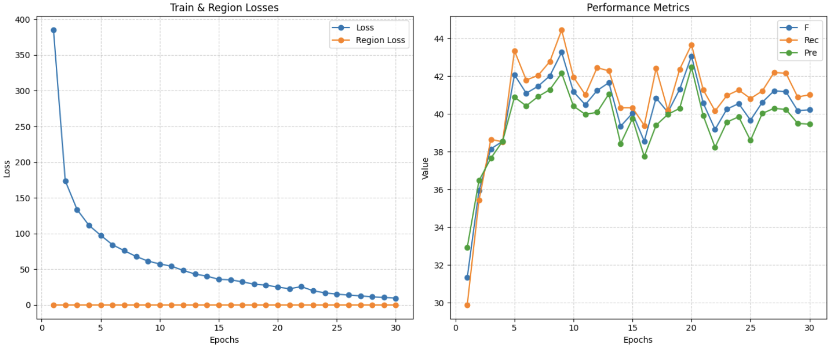
Ablation Study: disabling multimodality
best validation metrics: {'f1': 43.27, 'rec': 44.45, 'pre': 42.16}

Slide 12
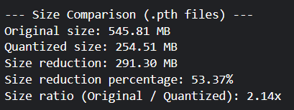
Compression Techniques: Quantization Aware Training
Quantization-aware training (QAT) is a technique used during the training of machine learning models, to simulate the effects of quantization (converting model weights and activations to lower precision formats like INT8)
Metrics during training: {'f1': 54.0, 'rec': 54.61, 'pre': 53.39}
Metrics after converting: {'f1': 6.51, 'rec': 4.65, 'pre': 10.84}

Slide 13
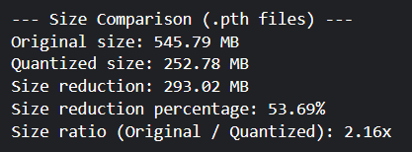
Compression Techniques: Dynamic Quantization
Dynamic quantization is a method of model compression where model weights are quantized offline (before runtime) and activations are quantized dynamically during inference
Validation Metrics {'f1': 53.36, 'rec': 51.35, 'pre': 55.54}
Time per task (CPU): Original 116.4 ms Quantized 83.3 ms

Slide 14
Conclusions and Future work
Implemented the model getting rid of outdated requirements
Conducted ablation study of only text vs text and image in two different ways
Implemented two ways to compress the model
As future work could be interesting to see how a modern Multimodal LLM does on this task.

Slide 15
References:
Yu, Jianfei, et al. ”Grounded multimodal named entity recognition on social media.” Proceedings of the 61st Annual Meeting of the Association for Computational Linguistics (Volume 1: Long Papers). 2023.

